Slide 1


PSYCHOLOGY
Chapter 15 PSYCHOLOGICAL DISORDERS
PowerPoint Image Slideshow

Slide 2
WHAT ARE PSYCHOLOGICAL DISORDERS?
DEFINITION OF A PSYCHOLOGICAL DISORDER
CULTURAL EXPECTATIONS
HARMFUL DYSFUNCTION
AMERICAN PSYCHOLOGICAL ASSOCIATION (APA) DEFINITION

Slide 3
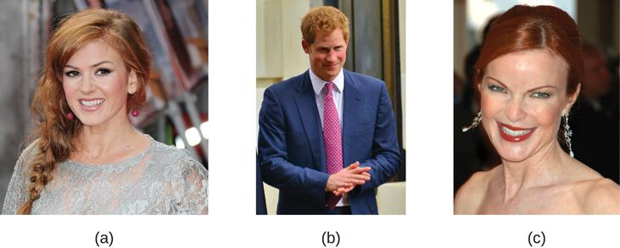
DEFINITION OF A PSYCHOLOGICAL
DISORDER
Psychopathology – the study of psychological disorders, including their symptoms, etiology (causes), and treatment.
Psychological disorder – a condition characterized by abnormal thoughts, feelings, and behaviors.
Behaviors, thoughts, and inner experiences that are atypical, dysfunctional, or dangerous are signs of psychological disorders.
However, there is no single definition of psychological abnormality or normality.
Just because something is atypical, does not mean it is disordered. Red hair is considered unusual, but not abnormal.
(a) Isla Fischer, (b) Prince Harry, and (c) Marcia Cross are three natural redheads.
Figure 15.2 (credit a: modification of work by Richard Goldschmidt; credit b: modification of work by Glyn Lowe; credit c: modification of work by Kirk Weaver)

Slide 4
DEFINITION OF A PSYCHOLOGICAL
DISORDER
Cultural Expectations
Violating cultural expectations is not enough by itself to identify a psychological disorder.
Social norms vary between cultures - what is considered appropriate in one culture may be viewed differently in another.
Hallucinations is a violation of cultural expectations in Western Societies. People who report hallucinations are likely to be labeled with a psychological disorder.
However, in some other cultures, certain types of hallucinations are highly valued.
Harmful Dysfunction
Wakefield (1992):
Proposed a more influential concept in which he defines psychological disorders as a harmful dysfunction.
Dysfunction occurs when an internal mechanism (e.g., cognition, perception, learning) breaks down and cannot perform its normal function.
For a dysfunction to be be classed as a disorder, it must also be harmful – leads to negative consequences for the individual or for others, as judged by the standards of the individual’s culture.

Slide 5
DEFINITION OF A PSYCHOLOGICAL
DISORDER
American Psychological Association (APA) Definition
A psychological disorder is a condition that consists of the following:
Significant disturbances in thoughts, feelings, and behaviors.
  Outside of cultural norms.
The disturbances reflect some kind of biological, psychological, or developmental dysfunction.
The disturbances lead to significant distress or disability in one’s life.
  E.g. difficulty performing appropriate and expected roles.
Despite the many existing definitions, there is no universal agreement on where the boundary between disordered and not disordered is.

Slide 6
DIAGNOSING & CLASSIFYING PSYCHOLOGICAL DISORDERS
THE DAGNOSTIC AND STATISTICAL MANUAL OF MENTAL DISORDERS (DSM)
THE INTERNATIONAL CLASSIFICATION OF DISEASES

Slide 7
THE DIAGNOSTIC & STATISTICAL MANUAL
OF MENTAL DISORDERS (DSM)
Diagnosis – appropriately identifying and labeling a set of defined symptoms
Requires classification systems that organize psychological disorders systematically.
Diagnostic and Statistical Manual of Mental Disorders:
Published by the American Psychiatric Association.
First published in 1952 and has since undergone numerous revisions.
  The first two editions listed homosexuality as a disorder but was removed in 1973.
DSM-5 is the classification system used by most mental health professionals.
Categorizes and describes each disorder.
  Diagnostic features – overview of the disorder.
  Diagnostic criteria – specific symptoms required for diagnosis.
  Prevalence – percent of population thought to be afflicted.
  Risk factors.
Provides information about comorbidity (the co-occurrence of two disorders).

Slide 8
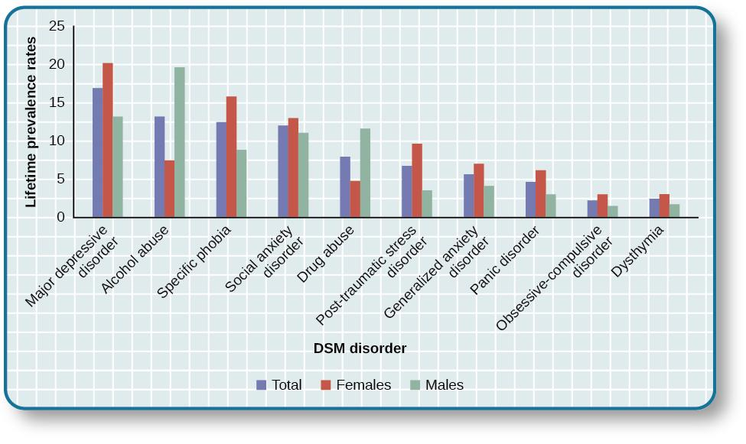
PREVALENCE RATES (DSM-IV)
The graph shows the breakdown of psychological disorders, comparing the percentage prevalence among adult males and adult females in the United States.
The DSM-IV, has since been supplanted by the DSM-5. Most categories remain the same; however, alcohol abuse now falls under a broader Alcohol Use Disorder category.
Figure 15.4

Slide 9
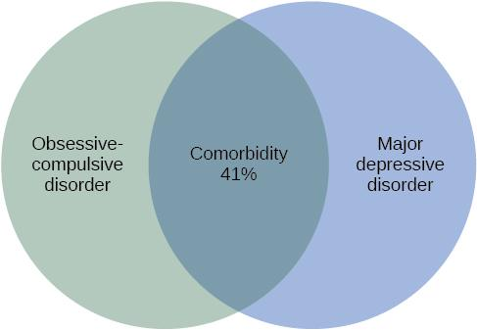
COMORBIDITY (DSM)
Obsessive-compulsive disorder and major depressive disorder frequently occur in the same person.
Figure 15.5

Slide 10
THE INTERNATIONAL CLASSIFICATION OF
DISEASES (ICD)
Published by the World Health Organization (WHO).
Classification and criteria for specific disorders are similar to the DSM but some differences exist.
Used to examine general health of populations and monitor prevalence of diseases/health problems internationally.
Worldwide, the ICD is more frequently used for clinical diagnosis, whereas the DSM is more valued for research.
DSM includes more explicit disorder criteria as well as extensive explanatory text.
DSM is the classification system used among U.S. mental health professionals.

Slide 11
PERSPECTIVES ON PSYCHOLOGICAL DISORDERS
SUPERNATURAL PERSPECTIVES
BIOLOGICAL PERSPECTIVES
THE DIATHESIS-STRESS MODEL

Slide 12
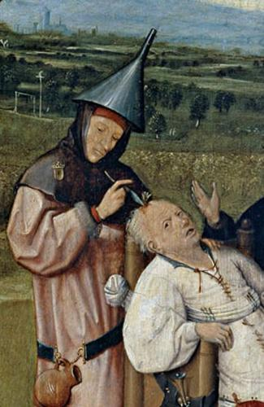
SUPERNATURAL PERSPECTIVES
For centuries, psychological disorders were viewed from a supernatural perspective.
Supernatural perspective – psychological disorders attributed to a force beyond scientific understanding.
Practitioners of black magic (sorcery).
Possessed by spirits.
Witchcraft.
Treatments included torture, beatings, and exorcism.
In The Extraction of the Stone of Madness, a 15th century painting by Hieronymus Bosch, a practitioner is using a tool to extract an object (the supposed “stone of madness”) from the head of an afflicted person.
Figure 15.6

Slide 13
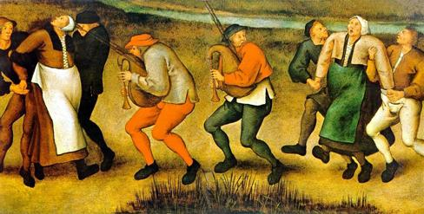
DANCING MANIA
Epidemic in Western Europe (11th-17th centuries) in which groups of people would suddenly begin to dance with wild abandon.
Some would dance for days or weeks, screaming of terrible visions.
Although the cause is unknown, the behavior was attributed by many to supernatural forces.
Figure 15.7

Slide 14
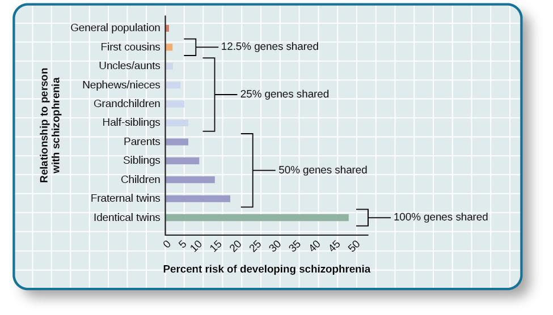
BIOLOGICAL PERSPECTIVES
View psychological disorders as linked to biological phenomena:
Genetic factors, chemical imbalances, and brain abnormalities.
Supported by evidence that most psychological disorders have a genetic component.
A person’s risk of developing schizophrenia increases if a relative has schizophrenia. The closer the genetic relationship, the higher the risk.
Heritability Estimates for Schizophrenia
Figure 15.8

Slide 15
DIATHESIS-STRESS MODEL
Psychosocial Perspective
Emphasizes the importance of learning, stress, faulty and self-defeating thinking patters, and environmental factors.
Views the cause of psychological disorders as a combination of biological and psychosocial factors.
Diathesis-Stress Model:
Integrates biological and psychosocial factors to predict the likelihood of a disorder.
Diathesis + Stress → Development of a disorder
People with an underlying predisposition for a disorder (diathesis) are more likely than others to develop a disorder when faced with adverse environmental or psychological events.
A diathesis can be a biological or psychological vulnerability.

Slide 16
ANXIETY DISORDERS
SPECIFIC PHOBIA
ACQUISTION OF PHOBIAS THROUGH LEARNING
SOCIAL ANXIETY DISORDER
PANIC DISORDER
GENERALIZED ANXIETY DISORDER

Slide 17
ANXIETY DISORDERS
Fear vs Anxiety
Fear – an instantaneous reaction to an imminent threat.
Anxiety – apprehension, avoidance, and cautiousness regarding a potential threat, danger, or other negative content.
Motivates us to take action, avoid certain things.
Level and duration of anxiety usually matches the magnitude of the potential threat. However, some people experience anxiety that is excessive, persistent and out of proportion with the actual threat.
Anxiety Disorders
Characterized by excessive and persistent fear and anxiety, and by related disturbances in behavior.
Prevalence:
Effects approximately 25%-30% of the U.S. population during their lifetime.
More common in women than men.
Most frequently occurring class of mental disorders.

Slide 18
SPECIFIC PHOBIA
Involves excessive, distressing, and persistent fear or anxiety about a specific object or situation.
People may realize their fear and anxiety is irrational but may still go to great lengths to avoid the stimulus.
Prevalence - affects 12.5% of the U.S. population at some point in their lifetime.
Common specific phobias include:
Acrophobia – heights.
Aerophobia – flying.
Arachnophobia – spiders.
Claustrophobia – enclosed spaces.
Agoraphobia:
Listed as a separate anxiety disorder.
Characterized by intense fear, anxiety, and avoidance of situations in which it might be difficult to escape or receive help if one experiences a panic attack.
These situations include public transportation, crowds, being outside the home alone.

Slide 19
ACQUISITION OF PHOBIAS THROUGH
LEARNING
Rachman (1977): 3 Major Learning Pathways
Classical Conditioning.
Child is bitten by dog (US) → dogs become associated with biting (CS) → child experiences fear around dogs (CR).
Conditioned fears develop more readily to fear-relevant stimuli (images of snakes and spiders) than to fear-irrelevant stimuli (images of flowers).
Vicarious Learning.
Child observes cousin react with fear around spiders → child later expresses the same fears even though spiders have never presented any danger to him.
Verbal transmission of information.
A child is continuously told that snakes are dangerous → child starts to fear snakes.
Why are certain types of phobias more common than others?
One theory argues that because our ancestors associated certain stimuli with danger (e.g., snakes, spiders, and heights), we are evolutionarily predisposed to associate those stimuli with fear.

Slide 20
SOCIAL ANXIETY DISORDER
Characterized by extreme and persistent fear or anxiety and avoidance of social situations in which the person could potentially be evaluated negatively by others, leading to serious impairments in life.
Associated with lower educational attainment, lower earning, poor work performance, unemployment.
Safety behaviors – mental or behavioral acts that reduce anxiety in social situations by reducing the chance of negative social outcomes.
  E.g., avoiding eye contact or rehearsing sentences before speaking.
Prevalence - experienced by about 12% of Americans during their lifetime.
Comorbidity - high rate of comorbidity with alcohol use disorder.
  Individuals may self-medicate to reduce anxiety in social situations.
Risk Factors
Fears of social situations possibly develop through conditioning.
  92% of a sample of adults with social anxiety disorder reported a history of severe teasing in childhood.
Behavioral inhibition – a consistent tendency to show fear and restraint when presented with unfamiliar people or situations.

Slide 21
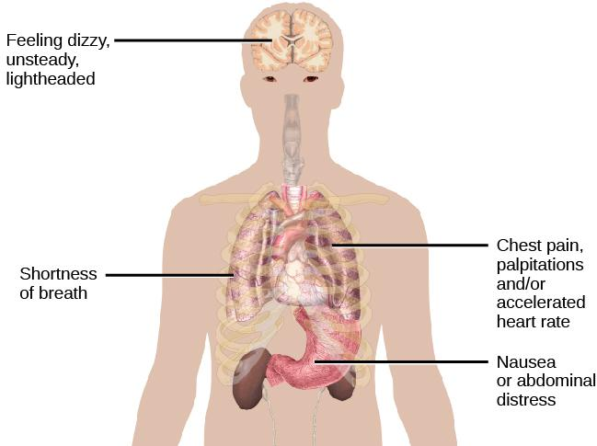
PANIC DISORDER
Panic disorder – recurrent and unexpected panic attacks, along with at least one month of persistent concern about additional panic attacks, worry over the consequences of the attacks, or self-defeating changes in behavior related to the attacks.
Comorbidity - anxiety disorders or major depressive disorder.
Panic attack – a period of extreme fear or discomfort that develops abruptly and reaches a peak within 10 minutes.
Can be expected (in response to an external trigger) or unexpected.
Panic attacks alone are not a disorder.
Some of the physical manifestations of a panic attack are shown. People may also experience sweating, trembling, feelings of faintness, or a fear of losing control, among other symptoms.
Figure 15.9

Slide 22
PANIC DISORDER
CAUSES
Genetics
43% heritability.
Neurobiological Theories
Locus coeruleus in the brainstem is possibly involved.
  Major source of norepinephrine (neurotransmitter that triggers flight-or-flight response).
  Activation is associated with anxiety and fear and produces panic-like symptoms in nonhuman primates.
Conditioning Theories
Panic attacks are classical conditioning responses to subtle bodily sensations resembling those normally occurring when one is anxious or frightened.
Cognitive Theories
Individuals with panic disorder are prone to interpret ordinary bodily sensations catastrophically, setting the state for panic attacks.
  In some patients, reducing catastrophic cognitions about sensations has proven to be as effective as medication in reducing panic attacks.

Slide 23
GENERALIZED ANXIETY DISORDER
A relatively continuous state of excessive, uncontrollable, and pointless worry and apprehension.
Diagnosis Criteria
The diffuse worrying and apprehension is not part of another disorder.
Symptoms occur more days than not for at least 6 months.
Symptoms are accompanied by any three of the following symptoms:
  Restlessness, difficulty concentrating, being easily fatigued, muscle tension, irritability, and sleep difficulties.
Prevalence
Affects about 5.7% of U.S. population during their lifetime.
Females are 2 times as likely as males to experience the disorder.
Comorbidity
Comorbid with mood disorders and other anxiety disorders.

Slide 24

GENERALIZED ANXIETY DISORDER
CAUSES
Cognitive Theories
Worry represents a mental strategy to avoid more powerful negative emotions perhaps stemming from earlier unpleasant or traumatic experiences.
  Worrying acts a distraction from remembering painful childhood experiences.
  Longitudinal study found childhood maltreatment was strongly related to development of the disorder during adulthood.
Figure 15.10 (credit: Freddie Peña)

Slide 25
OBSESSIVE-COMPULSIVE & RELATED DISORDERS
OBSESSIVE-COMPULSIVE DISORDER (OCD)
BODY DYSMORPHIC DISORDER
HOARDING DISORDER
CAUSES OF OCD

Slide 26
OBSESSIVE COMPULSIVE DISORDER (OCD)
Involves thoughts and urges that are intrusive and unwanted (obsessions) and/or the need to engage in repetitive behaviors or mental acts (compulsions).
Obsessions – persistent, unintentional, and unwanted thoughts and urges that are highly intrusive, unpleasant, and distressing.
Common obsessions:
Concerns about germs and contamination
Doubts
Order and symmetry
Aggressive or lustful urges
Compulsions – repetitive and ritualistic acts, typically carried out primarily as a means to minimize the distress that obsessions trigger or to reduce the likelihood of a feared event.
Not performed out of pleasure.
The person usually knows these obsessions and compulsions are irrational but suppressing them is extremely difficult.
Prevalence
Experienced by approximately 2.3% of the U.S. population in their lifetime.

Slide 27
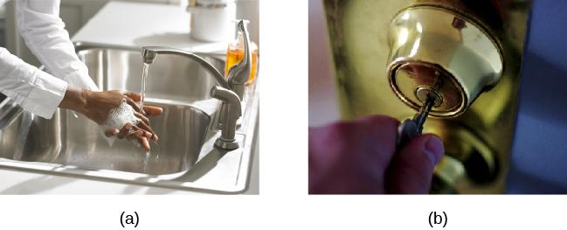
OBSESSIVE-COMPULSIVE DISORDER (OCD)
Repetitive hand washing and (b) checking (e.g., that a door is locked) are common compulsions among those with obsessive-compulsive disorder.
Other common compulsions include cleaning, ordering, and counting.
Figure 15.11 (credit a: modification of work by the USDA; credit b: modification of work by Bradley Gordon)

Slide 28
BODY DYSMORPHIC DISORDER
Involves a preoccupation with a perceived flaw in the individuals physical appearance that is either nonexistent or barely noticeable to other people.
Causes person to think they are unattractive or deformed.
Typically involve skin, face, or hair, but can focus on any bodily area.
Causes person to engage in repetitive and ritualistic behavioral and mental acts.
  Constantly looking in the mirror.
  Trying to hide the offending body part.
  Comparison with others.
  Cosmetic surgery.
Prevalence
Affects approximately 2.4% of adults in the U.S.
Slightly higher rates in women than in men.

Slide 29
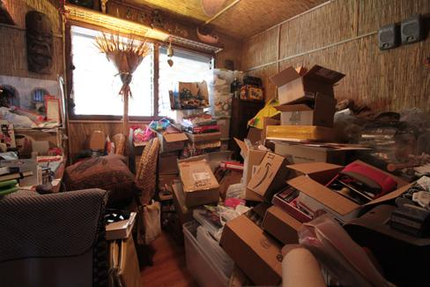
HOARDING DISORDER
Involves great difficulty in discarding possessions, regardless of how valueless/useless they are, usually resulting in an accumulation of items that clutter living or work areas.
Why are they unable to let go of items?
  They think items might be useful at a later time.
  Sentimental attachment to items.
Excessive clutter prevents the individual using necessary living spaces such as the kitchen or bed.
Diagnosed as long as the hoarding is not a symptom of another disorder.
Figure 15.12 (credit: “puuikibeach”/Flickr)

Slide 30
OCD CAUSES
Genetics
5 times more frequent in first-degree relatives of people with OCD.
Identical twins - 57% concordance rate.
Fraternal twins - 22% concordance rate.
Genes involved regulate the function of serotonin, dopamine, and glutamate.
Conditioning Theories
Symptoms of OCD are learned responses resulting from both classical and operant conditioning.
  Neutral stimulus + unconditioned stimulus → anxiety or distress.
  Once association has been acquired, encounters with the NS trigger anxiety and obsessive thoughts.
  Anxiety and obsessive thoughts continue until a strategy is identified to relieve it.
  Relief may be ritualistic behavior or mental activity that reduces anxiety.
  Compulsive acts become negatively reinforcing.

Slide 31
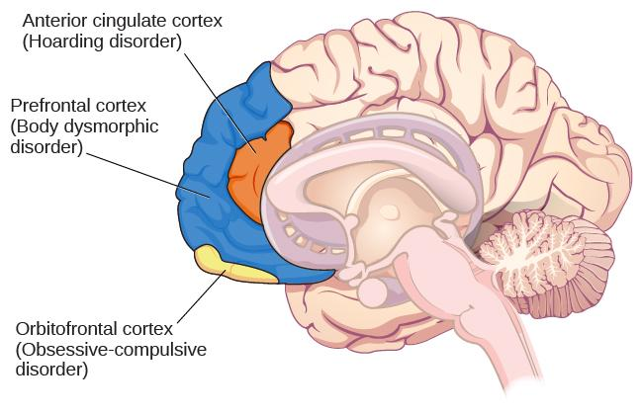
OCD CAUSES
Brain Anatomy
OCD Circuit:
Several interconnected regions that influence perceived emotional value of stimuli and selection of behavioral and cognitive responses.
Abnormalities in these areas may produce symptoms of OCD.
Orbitofrontal cortex – involved in learning and decision making.
Becomes hyperactive in people with OCD when provoked with tasks such as looking at photos of a toilet or a pictures hanging crookedly on a wall.
Figure 15.13

Slide 32
POSTTRAUMATIC STRESS DISORDER
DEFINITION OF PTSD
RISK FACTORS
SUPPORT FOR SUFFERERS
LEARNING & THE DEVELOPMENT OF PTSD

Slide 33
DEFINITION OF PTSD
Diagnosis Criteria
Individual was exposed to, witnessed, or experienced the details of a traumatic experience (“actual or threatened death, serious injury, or sexual violence”) (APA, 2013).
  PTSD was first recognized in soldiers who had engaged in combat.
Symptoms occur for at least one month.
Symptoms
Intrusive and distressing memories of the event.
Flashbacks – states during which individual relives the event and behaves as if it were occurring at that moment.
Avoidance of stimuli connected to the event.
Persistently negative emotional states.
Feelings of detachment from others.
Irritability.
Proneness toward outbursts.
Exaggerated startle response.
Prevalence - Experienced by approximately 7% of the U.S. population in their lifetime.

Slide 34
RISK FACTORS FOR PTSD
Risk Factors
Trauma experience.
Those involving harm by others carry greater risk than those that do not.
Lack of immediate social support.
  Social Support (comfort, advice, and assistance from relatives, friends, and neighbors) can reduce the risk of developing PTSD.
Subsequent life stress.
Female gender.
Low socioeconomic status.
Low intelligence.
Personal history of mental disorders.
History of childhood adversity.
Family history of mental disorders.
Personality characteristics – neuroticism and somatization (tendency to experience physical symptoms when one encounters stress).
Possession of one or two short versions of a gene that regulates serotonin.

Slide 35
LEARNING & THE DEVELOPMENT OF PTSD
Conditioning Theories
Traumatic event (UCS) → Extreme fear and anxiety (UCR).
Cognitive, emotional, physiological, and environmental cues associated with the traumatic event become conditioned stimuli.
Traumatic reminders (CS) → Extreme fear and anxiety (CR).
Cognitive Theories
Two key processes in development and maintenance of PTSD:
Disturbances in memory for the event.
  Poorly encoded memories of trauma can become fragmented, disorganized, and lacking in detail.
  Individuals cannot remember event in a way that gives meaning and context.
  May become haunted by these fragments involuntarily triggered by stimuli associated with the event.
Negative appraisals of the trauma and its aftermath (e.g., ”I deserve to be raped because I am stupid”).
  May lead to dysfunctional behavioral patterns that maintain symptoms and prevent changes in the problematic appraisals.

Slide 36
MOOD DISORDERS
MAJOR DEPRESSIVE DISORDER
SUBTYPES OF DEPRESSION
BIPOLAR DISORDER
THE BIOLOGICAL BASIS OF MOOD DISORDERS
COGNITIVE THEORIES OF DEPRESSION
SUICIDE

Slide 37

MOOD DISORDERS
Characterized by massive disruptions in mood and emotions that can cause a distorted out look on life, and impair ability to function.
Depressive Disorders
Depression (intense and persistent sadness) is the main feature.
Bipolar and Related Disorders
Mania (extreme elation and agitation) is the main feature.
Manic episode – “a distinct period of abnormally and persistently elevated, expansive, or irritable mood and abnormally and persistently increased activity or energy lasting at least one week.” (APA, 2013).
Figure 15.15 (credit: Kiran Foster)

Slide 38
MAJOR DEPRESSIVE DISORDER
Diagnosis Criteria
“Depressed mood most of the day, nearly every day” (APA, 2013).
Loss of interest and pleasure in usual activities.
At least 5 symptoms for at least a two-week period.
Symptoms cause significant distress or impair normal functioning and are not caused by substances or a medical condition.
Major depressive disorder is episodic (symptoms are usually present at their full magnitude for a certain period of time and then gradually diminish).
Symptoms
Weight loss or weight gain/increased or decreased appetite.
Difficulty falling asleep or too much sleep.
Psychomotor agitation or psychomotor retardation.
Fatigue/loss of energy.
Feelings of worthlessness or guilt.
Difficulty concentrating, indecisiveness.
Suicidal ideation – thoughts of death, thinking about/planning suicide, suicide attempt.

Slide 39
MAJOR DEPRESSIVE DISORDER
Prevalence
Affects around 6.6% of the U.S. population each year and 16.9% of the U.S. population in their lifetime.
More common among women than men.
Comorbidity
Comorbid with anxiety disorders and substance abuse disorders.
Risk Factors
Unemployment.
Low income.
Living in urban areas.
Being separated, divorced, or widowed.

Slide 40

SUBTYPES OF DEPRESSION
Seasonal pattern – applies to situations in which a person experiences the symptoms of major depressive disorder only during a particular time of year.
Peripartum onset (postpartum depression) – major depression during pregnancy or in the four weeks following the birth.
Persistent depressive disorder (dysthymia) – depressed moods most of the day nearly every day for at least two years, as well as at least two of the other symptoms of major depression.
Chronically sad but do not meet all the criteria for major depression.
(Credit: Psychiatry Advisor)

Slide 41
BIPOLAR DISORDER
Involves mood states that fluctuate between depression and mania.
Symptoms of Mania
Excessively talkative.
Excessively irritable.
Exhibit flight of ideas – talk loudly and rapidly, abruptly switching from one topic to another.
Easily distracted.
Exhibit grandiosity – inflated but unjustified self-esteem and self-confidence.
Show little need for sleep.
Take on several tasks at once.
Engage in reckless behaviors.
Prevalence
Onset is typically before the age of 25.
Affects 1 out of 100 people in the U.S. in their lifetime.
36% of these individuals attempt suicide.
Comorbidity - anxiety disorder and substance abuse disorder.

Slide 42
BIOLOGICAL BASIS OF MOOD DISORDERS
Genetics
Major Depressive Disorder:
Relatives have double the risk of developing the disorder.
Identical twins – 50% concordance rate.
Fraternal twins – 38% concordance rate .
Bipolar Disorder:
Relatives have over 9 times the risk.
Identical twins – 67% concordance rate.
Fraternal twins – 16% concordance rate.
Hormones
Elevated levels of cortisol (stress hormone) are found in depression.
Cause or consequence of depression?
A risk factor for future depression.
Cortisol activates the amygdala and deactivates the prefrontal cortex (disturbances connected to depression).

Slide 43
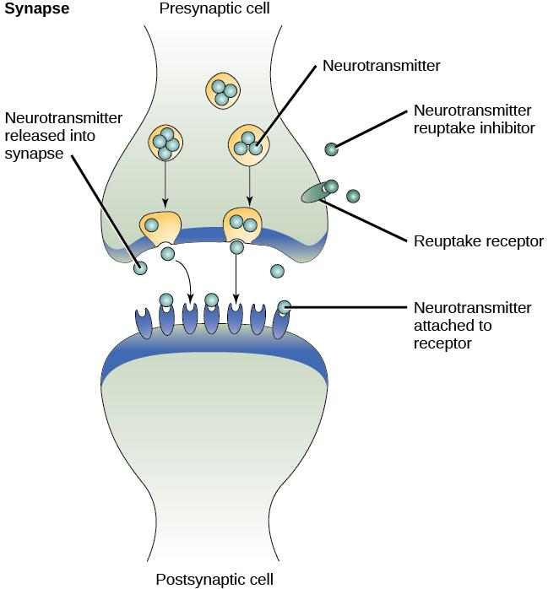
BIOLOGICAL BASIS OF MOOD DISORDERS
Neurotransmitters
Mood disorders often involve imbalances in neurotransmitters.
Particularly serotonin and norepinephrine.
These neurotransmitters are involved in bodily functions that are disrupted in mood disorders.
Many medications designed to treat mood disorders work by altering neurotransmitter activity in the neural synapse.
Medications for depression – usually increase serotonin and norepinephrine activity.
Medication for bipolar – Lithium, which blocks norepinephrine activity at the synapse.
Figure 15.16

Slide 44

BIOLOGICAL BASIS OF MOOD DISORDERS
Brain Anatomy
Depression:
Amygdala – important in assessing the emotional significance of stimuli and experiencing emotions.
  Depressed individuals react to negative emotional stimuli, such as sad faces, with greater amygdala activation than do non-depressed individuals.
  More prone to react emotionally to negative stimuli.
Prefrontal cortex – important in regulating and controlling emotions.
  Decreased activation in depressed individuals which may inhibit its ability to override negative emotions.
  Greater difficulty controlling emotional reactions.
Figure 15.17 (credit: Ian Munroe)

Slide 45
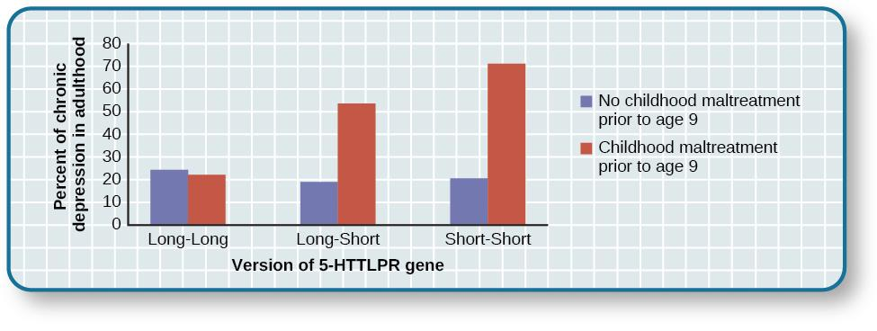
DIATHESIS-STRESS MODEL & MAJOR
DEPRESSIVE DISORDERS
Stressful life events often precede the onset of depressive episodes.
However, not everyone who experiences stressful life events develop depression, suggesting predispositions or vulnerability factors could be involved.
Genetic vulnerability:
Alteration in the 5-HTTLPR gene (regulates serotonin).
1 or 2 short alleles + stressful life events → increasingly likely to experience a depressive episode.
A study on gene-environment interaction in people experiencing chronic depression in adulthood suggests a much higher incidence in individuals with a short version of the gene in combination with childhood maltreatment (Brown & Harris, 2013).
Figure 15.18

Slide 46
COGNITIVE THEORIES OF DEPRESSION
Cognitive theories suggest that depression is triggered by negative thoughts, interpretations, self-evaluations, and expectations.
Diathesis-Stress model: cognitive vulnerability + stressful life events → depression.
Aaron Beck (1960s)
Theorized that depression-prone people possess mental predispositions to think about most things in a negative way (depressive schemas).
Depressive schemas – contain themes of loss, failure, rejection, worthlessness, and inadequacy.
May develop in childhood in response to adverse experiences.
Dormant until activated by stressful or negative life events.
Prompt dysfunctional and pessimistic thoughts about the self, world, and the future.
Maintained by cognitive biases which lead us to focus on negative aspects of experiences, interpret things negatively, and block positive memories.
Supported by research.
Lead to the development of cognitive therapies.

Slide 47
COGNITIVE THEORIES OF DEPRESSION
Hopelessness Theory
Specific negative thinking style → sense of hopelessness → depression.
Negative thinking – refers to a tendency to perceive negative life events as having stable (”It’s never going to change”) and global (“It’s going to affect my whole life”) causes.
  Creates view that the life event will have negative implications for the person’s future and self-worth, increasing likelihood of hopelessness.
Hopelessness - expectation that unpleasant outcomes will occur or desired outcomes will not occur, and there is nothing one can do to prevent such outcomes (seen as the primary cause of depression).
Rumination
Distressed mood → Rumination → increased risk and duration of mood.
Rumination – repetitive and passive focus on the fact that one is depressed and dwelling on depressed symptoms, rather than distracting one’s self from the symptoms or attempting to address them in an active, problem-solving manner.
Described to explain higher rates of depression in women, who are more likely to ruminate, than in men.

Slide 48
SUICIDE
Statistics
90% of those who complete suicides have a diagnosis of at least one mental disorder (most frequently mood disorders).
10th leading cause of death for all ages in 2010 (an average of 105 each day).
4 times higher among males (79% of all suicides) than females.
Males most commonly use fire arms, females most commonly use poison.
Risk Factors
Substance abuse problems (10 times greater in individuals with alcohol dependence).
Previous suicide attempts.
Access to lethal means in which to act (e.g., firearm in the home).
Precursors – withdrawal from social relationships, feeling like a burden, engaging in reckless and risk-taking behaviors.
Sense of entrapment (feeling unable to escape feelings or external circumstances).
Cyberbullying.
Suicide of a family member.
Serotonin dysfunction.

Slide 49
SCHIZOPHRENIA
SYMPTOMS
CAUSES

Slide 50
SCHIZOPHRENIA: SYMPTOMS
Hallucinations – perceptual experience that occurs in the absence of external stimulation. (Auditory hallucinations are most common).
Delusions – beliefs that are contrary to reality.
Paranoid delusions – belief that other people or agencies are plotting to harm them.
Grandiose delusions – belief that one holds special power, unique knowledge, or is extremely important.
Somatic delusions – belief that something highly abnormal is happening to one’s body.
Thought withdrawal/insertion.
Disorganized thinking – disjointed and incoherent thought processes.
Disorganized or abnormal motor behavior – unusual behaviors/movements.
Catatonic behaviors – decreased reactivity to the environment
Negative Symptoms - decreases and absences in certain behaviors, emotions, drives.
Avolition – lack of motivation to engage in self-initiated and meaningful activity.
Alogia – reduced speech output.
Asociality – social withdrawal.
Anhedonia – inability to experience pleasure.

Slide 51
SCHIZOPHRENIA
CAUSES
Prevalence – Affects 1% of the population.
Genetics
Risk is 6 times greater if one parent has schizophrenia (even if adopted).
Neurotransmitters
Dopamine hypothesis – an overabundance of dopamine or too many dopamine receptors are responsible for the onset and maintenance of schizophrenia.
  Drugs that increase dopamine levels can produce schizophrenia-like symptoms.
  Medications that block dopamine activity reduce the symptoms.
High levels of dopamine in the limbic system → hallucinations and delusions.
Low levels of dopamine in the prefrontal cortex → negative symptoms.
Brain Anatomy
Enlarged ventricles.
Reduced gray matter in the frontal lobes.
Many show less frontal lobe activity when performing cognitive tasks.
Events During Pregnancy
Obstetric complications during birth.
Mother’s exposure to influenza during the first trimester.
Mother’s emotional stress.

Slide 52
DISSOCIATIVE DISORDERS
DISSOCIATIVE AMNESIA
DEPERSONALIZATION/DEREALIZATION DISORDER
DISSOCIATIVE IDENTITY DISORDER

Slide 53
DISSOCIATIVE DISORDERS
Characterized by an individual becoming split off, or dissociated, from their core sense of self - Memory and identity become disturbed.
Dissociative Amnesia - Inability to recall important personal information.
Usually follows a stressful or traumatic experience.
Dissociative fugue – individual suddenly wanders away from home, experiences confusion about their identity, and in some cases may adopt a new identity.
Depersonalization/Derealization Disorder - Characterized by recurring episodes of depersonalization, derealization, or both.
Depersonalization – feelings of “unreality or detachment from, or unfamiliarity with, one’s whole self or from aspects of the self” (APA 2013).
Derealization – a sense of ”unreality or detachment from, or unfamiliarity with, the world, be it individuals, inanimate objects, or all surroundings” (APA, 2013).
Dissociative Identity Disorder (formerly multiple personality disorder) - Individual exhibits two or more separate personalities or identities.
Involves memory gaps for the time during which another identity is in charge.
Individuals tend to report a history of childhood trauma - Adoption of multiple personalities may serve as a psychologically important coping mechanism for threat and danger.

Slide 54
PERSONALITY DISORDERS
BORDERLINE PERSONALITY DISORDER
ANTISOCIAL PERSONALITY DISORDER

Slide 55
PERSONALITY DISORDERS
Characterized by a pervasive and inflexible personality style that differs markedly from the expectations of the individuals culture and causes distress or impairment.
Begins in adolescence or early adulthood.
Prevalence
Slightly over 9% of the U.S. population suffers from a personality disorder.
Avoidant and schizoid personality disorders are most frequent.
Antisocial and borderline personality disorder are most problematic.
Cluster A
Paranoid personality disorder
Schizoid personality disorder
Schizotypal personality disorder
Cluster B
Antisocial personality disorder
Histrionic personality disorder
Narcissistic personality disorder
Borderline personality disorder
Cluster C
Avoidant personality disorder
Dependent personality disorder
Obsessive-compulsive personality disorder

Slide 56
BORDERLINE PERSONALITY DISORDER
Characterized by instability in interpersonal relationships, self-image, and mood, as well as marked impulsivity.
Symptoms
Cannot tolerate the thought of being alone – will make frantic efforts to avoid abandonment or separation.
Relationships are intense and unstable.
Unstable view of self – might suddenly display a shift in personal attitudes, interests, career plans, and choice of friends.
May be highly impulsive and may engage in reckless and self-destructive behaviors.
May sometimes show intense and inappropriate anger.
Can be moody, sarcastic, bitter and verbally abusive.
Prevalence – afflicts 1.4% of the U.S. population.
Comorbidity – anxiety, mood, and substance use disorders.
Causes
Core personality traits such as impulsivity and emotional instability show a high degree of heritability.
Many individuals report childhood abuse.

Slide 57
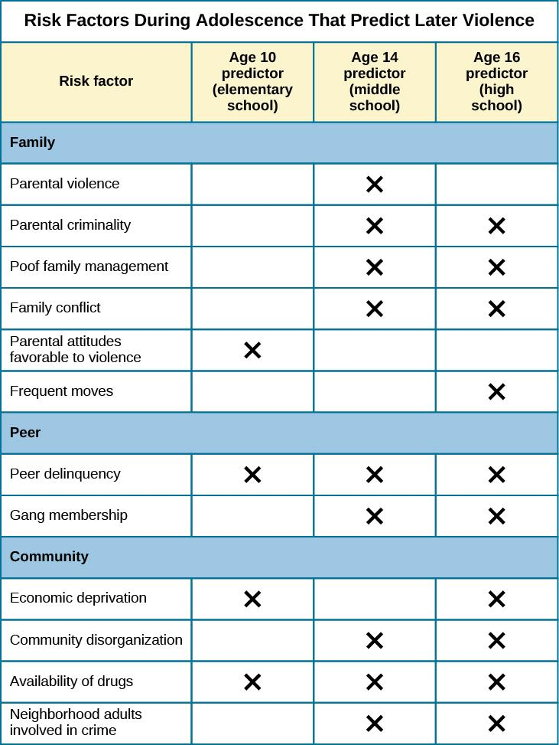
ANTISOCIAL PERSONALITY DISORDER
Characterized by complete lack of regard for other people’s rights or feelings.
Symptoms
Repeatedly performing illegal acts.
Lying to or conning others.
Impulsivity and recklessness.
Irritability and aggressiveness.
Failure to act in responsible ways.
Lack of remorse.
Overinflated sense of self.
Superficial charm.
Lack ability to empathize.
Diagnosis requires individual to be at least 18 years old.
Prevalence
Observed in 3.6% of the population.
More common in males.
Figure 15.19

Slide 58
ANTISOCIAL PERSONALITY DISORDER
CAUSES
Genetics
Personality and temperament dimensions related to this disorder (fearlessness, impulsive antisociality, and callousness) have a genetic influence.
Adoption studies suggest antisocial behavior is determined by the interaction of genetic factors and adverse environmental circumstances.
Emotional Deficits
Individuals with antisocial personality disorder fail to show fear in response to environment cues that signal punishment, pain, or noxious stimulation.
Show less skin conductance which may indicate emotional deficits.
Brain Anatomy
Research has revealed:
Less activation in brain regions involved in the experience of empathy and feeling concerned for others.
Greater activation in a brain area involved in self-awareness, cognitive function and interpersonal experience.

Slide 59
DISORDERS IN CHILDHOOD
ATTENTION DEFICIT/HYPERACTIVITY DISORDER (ADHD)
AUTISM SPECTRUM DISORDER

Slide 60
ADHD
ADHD is a neurodevelopmental disorder.
Neurodevelopmental disorders – involve developmental problems in personal, social, academic, and intellectual functioning.
ADHD - constant pattern of inattention and/or hyperactive and impulsive behavior that interferes with normal functioning.
Symptoms
Inattention:
Difficulty sustaining attention.
Failure to follow instructions.
Disorganization.
Lack of attention to detail.
Easily distracted and forgetful.
Hyperactivity:
Excessive movement.
Interrupting and intruding on others.
Blurting out responses before questions have been completed.
Difficulty waiting ones turn.
Prevalence
Occurs in about 5% of children.
Boys are 3 times more likely to have ADHD than girls.
Life Problems
Low educational attainment, low socioeconomic status, unemployment, low wages, substance abuse problems, and relationship problems.

Slide 61
ADHD
CAUSES
Genetics
Inattention – 71% heritable.
Hyperactivity – 73% heritable.
Neurotransmitters
Dopamine:
Genes involved are thought to include at least two that are important in the regulation of dopamine.
Individuals with ADHD show less dopamine activity in key brain regions (especially those associated with motivation and reward.
Medications have stimulant qualities and elevate dopamine activity.
Brain Anatomy
Studies show smaller frontal lobe volume and less activation when performing mental tasks.
Frontal lobe inhibits behavior – may explain hyperactive, uncontrolled behavior of ADHD.

Slide 62
AUTISM SPECTRUM DISORDER
Symptoms
Deficits in social interaction (e.g., do not make eye contact, turn head away when spoken to, prefer playing alone).
Deficits in communication (e.g., one word responses, difficulty maintaining conversation, echoed speech, and problems using and understanding nonverbal cues).
Repetitive patterns of behavior or interests.
Prevalence
Affects approximately 1 in 88 children in the U.S.
5 times more common in boys.
Causes
Genetics:
Identical twins – 60%-90% concordance rates.
Fraternal twins – 5%-10% concordance rates.
Genes involved are those important in the formation of synaptic circuits that facilitate communication between different areas of the brain.
Environment:
Factors that contribute to new mutations (e.g. pollutants).

